Slide 1

19 June 2017
Artificial Intelegence | CHAPPIE
def CHAPPIE (ChessGoGame) :
CHESS GO ARTIFICIAL INTELEGENCE
Randy N. T |
James Riady |
Ivan Eko

Slide 2
1
ALGORITHM

Slide 3
HEURISTIC SEARCH
MINIMAX ALGORITHM

Slide 4

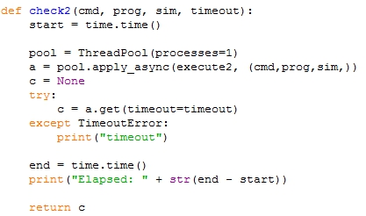

Slide 5
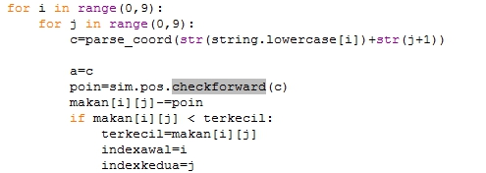
MEMULAI HEURISTIC
SEARCH

Slide 6
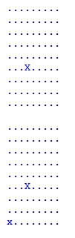


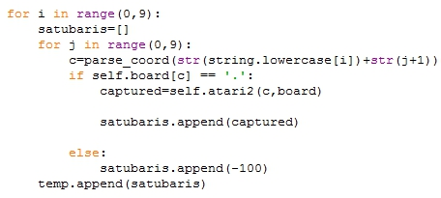
X = Player 1
x = Player 2 (AI)

Slide 7



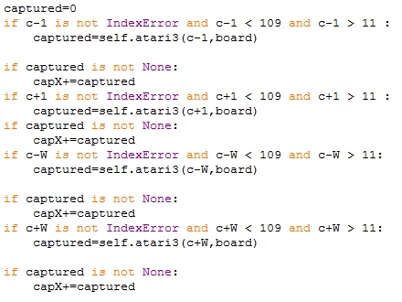

Slide 8

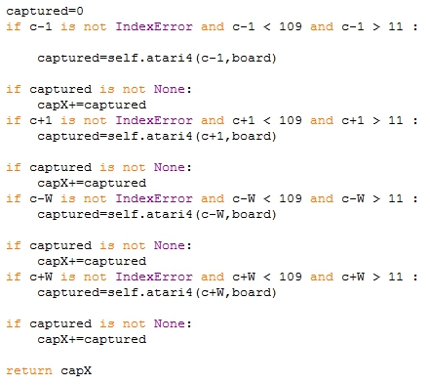



Slide 9




Slide 10
ATARI3
CHECKFORWARD
ATARI2
ATARI4
Jika meletakan stone disini maka bisa
di Atari oleh Player 1 dalam beberapa
langkah
BAD MOVE

Slide 12
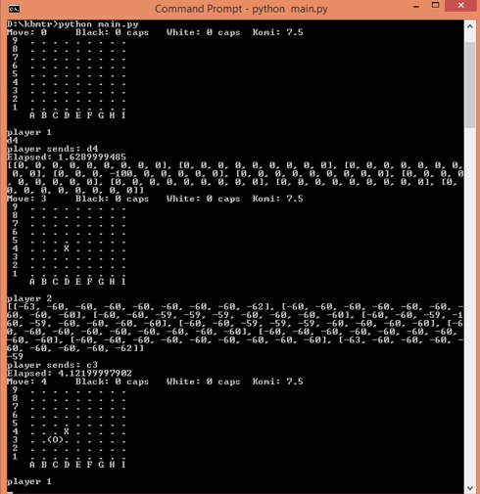

Slide 13
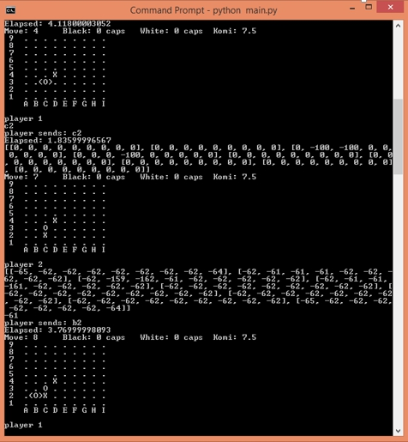

Slide 14
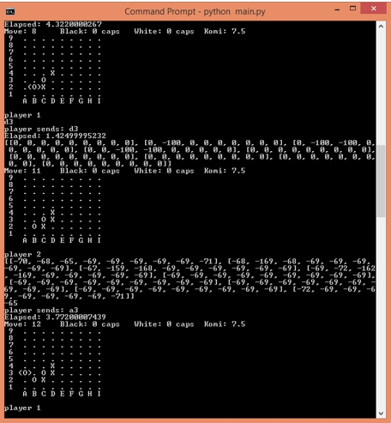

Slide 15
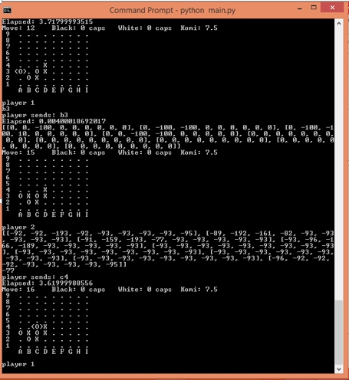

Slide 16
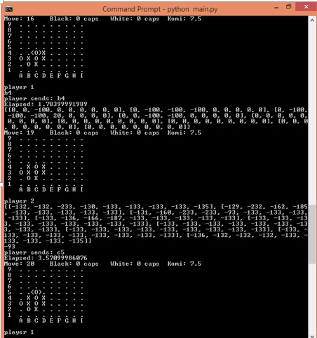

Slide 17
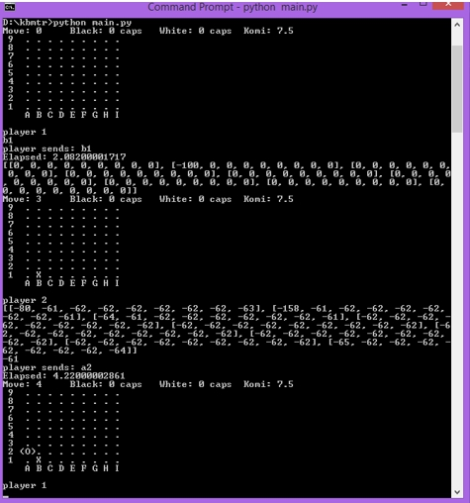

Slide 18
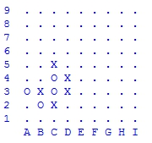
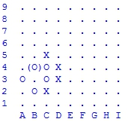

Slide 19
19 June 2017
Artificial Intelegence | CHAPPIE
def CHAPPIE (ChessGoGame) :
CHESS GO ARTIFICIAL INTELEGENCE
Randy N. T |
James Riady |
Ivan Eko

